Slide 1

Buying cards
Team SCV – Chu Jae Hun

Slide 2
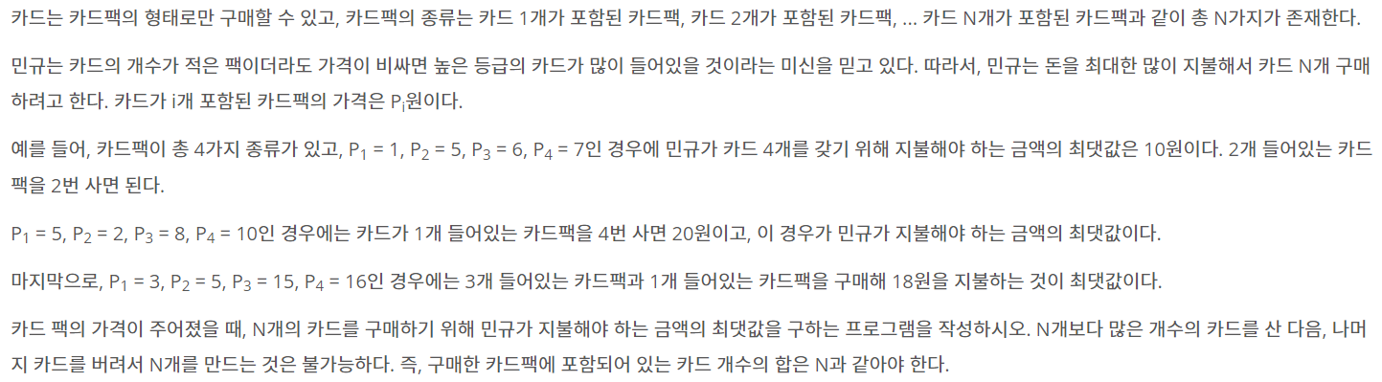
About Problem..

Slide 3


Idea..
D[1] = arr[1] = 3
D[2] = arr[2] or arr[1] + arr[1] (max)
-> arr[1] + D[1]
D[3] = arr[3] or arr[1] + arr[2] or arr[2] + arr[1] (max)
D[4] = …
(i = 1~n j = 1~i)
D[i] = D[i-j] + arr[j]

Slide 4
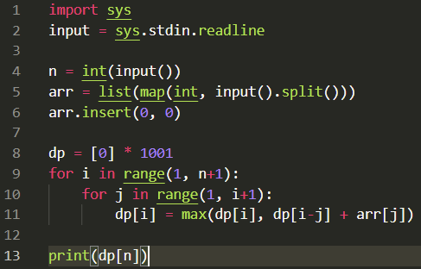
Procedure..
Input..
Insert(0, 0)
(#dp’s index = arr’s index)

Slide 5
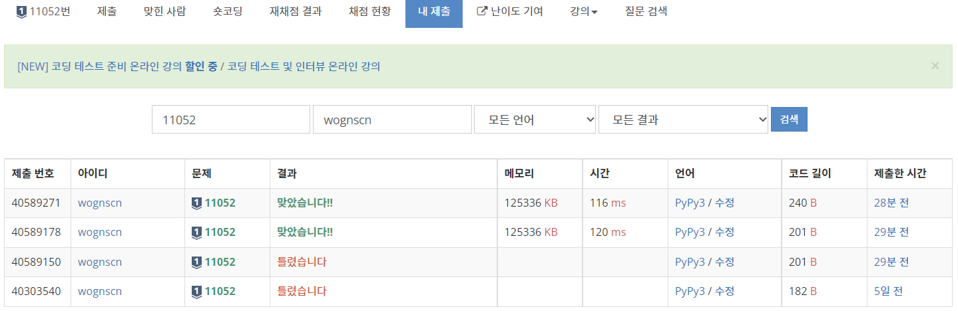
Result/Feedback
Index error
Algorithm error

